Slide 2
Lect-2 (UNIT-1) Overview of Computer organization and Programming fundamentals

Slide 3


Till date
Block diagram of computer System
Basic Components of Computer System
Memory Type : Primary and secondary
Memory Hierarchy
32 & 64 bit CPU processing
And ????

Slide 4
CPU OPERATION
Three basic CPU operations are : Fetch, Decode and Execute
Fetch Next Instruction
One Instruction Cycle Completed
Execute Instruction
Decode Instruction
Notes:
A central processing unit (CPU) is the electronic circuitry within a computer that carries out the instructions of a computer program by performing the basic arithmetic, logical, control and input/output (I/O) operations specified by the instructions. The term has been used in the computer industry at least since the early 1960s. Traditionally, the term “CPU” refers to a processor, more specifically to its processing unit and control unit (CU), distinguishing these core elements of a computer from external components such as main memory and I/O circuitry.
The form, design and implementation of CPUs have changed over the course of their history, but their fundamental operation remains almost unchanged. Principal components of a CPU include the arithmetic logic unit (ALU) that performs arithmetic and logic operations, processor registers that supply operands to the ALU and store the results of ALU operations, and a control unit that fetches instructions from memory and “executes” them by directing the coordinated operations of the ALU, registers and other components.
Operation
The fundamental operation of most CPUs, regardless of the physical form they take, is to execute a sequence of stored instructions that is called a program. The instructions to be executed are kept in some kind of computer memory. Nearly all CPUs follow the fetch, decode and execute steps in their operation, which are collectively known as the instruction cycle

Slide 5
The CPU and Main Memory
Notes:
CPU and main memory interact with each other
Control : it is Control unit (CU) , send and receive signals to memory and CPU
MAR : Memory Address Register holds the address of a memory block in which read or write operations are performed
MDR : Memory Data Register holds data waiting to be written in or data read from the location pointed by the MAR
D : De-multiplexer or DEMUX receives digital information from a single source and converts it into several sources
Address lines( Address bus) : is Unidirectional because the microprocessor is addressing a specific memory location. No outside devices can not write into Microprocessor (CPU).
Data Lines (Data bus )is Bidirectional because the CPU can read data from memory or write data to the memory
Main memory :RAM

Slide 6
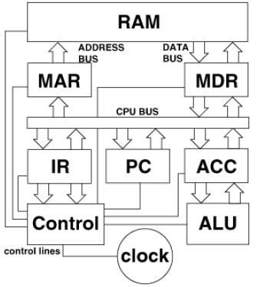
Inside the CPU
Memory Data Register
Memory Address Register
Accumulator (Working Register)
Instruction Register
Program Counter
Arithmetic and logic Unit
System Clock
Notes:
MAR and MDR : already discussed
IR :instruction register (IR) or current instruction register (CIR) is the part of a CPU’s control unit that holds the instruction currently being executed or decoded. In simple processors, each instruction to be executed is loaded into the instruction register, which holds it while it is decoded, prepared and ultimately executed, which can take several steps.
PC : program counter is a register in a computer processor that contains the address (location) of the instruction being executed at the current time. As each instruction gets fetched, the program counter increases its stored value by 1
Accumulator : register used for short-term, intermediate storage of arithmetic and logic data in a computer's CPU.
System clock : An electronic device in a computer that issues a steady high-frequency signal that synchronizes all the internal components.
Clock rate
Most CPUs are synchronous circuits, which means they employ a clock signal to pace their sequential operations. The clock signal is produced by an external oscillator circuit that generates a consistent number of pulses each second in the form of a periodic square wave. The frequency of the clock pulses determines the rate at which a CPU executes instructions and, consequently, the faster the clock, the more instructions the CPU will execute each second.

Slide 7
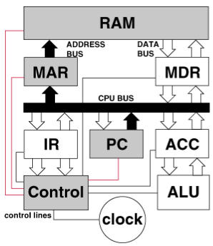
FETCH the instruction
Address of the next instruction is transferred from PC to MAR
The instruction is located in memory
Notes:
Fetch
The first step, fetch, involves retrieving an instruction (which is represented by a number or sequence of numbers) from program memory. The instruction’s location (address) in program memory is determined by a program counter (PC), which stores a number that identifies the address of the next instruction to be fetched. After an instruction is fetched, the PC is incremented by the length of the instruction so that it will contain the address of the next instruction in the sequence. Often, the instruction to be fetched must be retrieved from relatively slow memory, causing the CPU to stall while waiting for the instruction to be returned. This issue is largely addressed in modern processors by caches and pipeline architectures

Slide 8
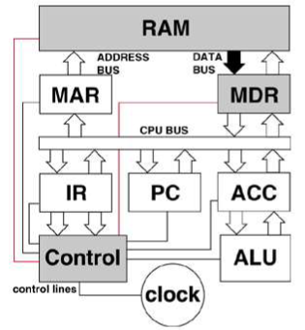
FETCH the instruction
3. instruction is copied from memory to MDR

Slide 9
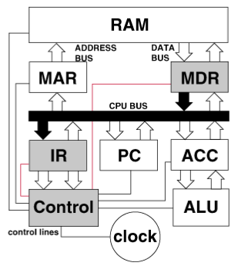
DECODE the instruction
Instruction is transferred to and decoded in the IR
Notes:
Decode
The instruction that the CPU fetches from memory determines what the CPU will do. In the decode step, performed by the circuitry known as the instruction decoder, the instruction is converted into signals that control other parts of the CPU.
The way in which the instruction is interpreted is defined by the CPU’s instruction set architecture (ISA). Often, one group of bits (that is, a “field”) within the instruction, called the opcode, indicates which operation is to be performed, while the remaining fields usually provide supplemental information required for the operation, such as the operands. Those operands may be specified as a constant value (called an immediate value), or as the location of a value that may be a processor register or a memory address, as determined by some addressing mode.
In some CPU designs the instruction decoder is implemented as a hardwired, unchangeable circuit. In others, a microprogram is used to translate instructions into sets of CPU configuration signals that are applied sequentially over multiple clock pulses. In some cases the memory that stores the microprogram is rewritable, making it possible to change the way in which the CPU decodes instructions.

Slide 10
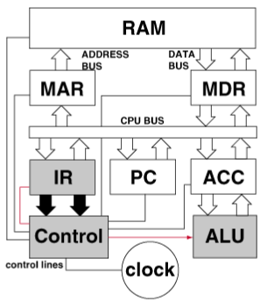
EXECUTE the instruction
Control unit sends signals to appropriate devices to cause execution of the instruction
Notes:
Execute
After the fetch and decode steps, the execute step is performed. Depending on the CPU architecture, this may consist of a single action or a sequence of actions. During each action, various parts of the CPU are electrically connected so they can perform all or part of the desired operation and then the action is completed, typically in response to a clock pulse. Very often the results are written to an internal CPU register for quick access by subsequent instructions. In other cases results may be written to slower, but less expensive and higher capacity main memory.
For example, if an addition instruction is to be executed, the arithmetic logic unit (ALU) inputs are connected to a pair of operand sources (numbers to be summed), the ALU is configured to perform an addition operation so that the sum of its operand inputs will appear at its output, and the ALU output is connected to storage (e.g., a register or memory) that will receive the sum. When the clock pulse occurs, the sum will be transferred to storage and, if the resulting sum is too large (i.e., it is larger than the ALU’s output word size), an arithmetic overflow flag will be set.

